Slide 1
HIGH PERFORMANCE COMPUTING ARCHITECTURES
MCE361T
UNIT -4
Overview of OpenMP and GPU Architectures

Slide 2
Overview of OpenMP and GPU Architectures
Introduction
The idea of OpenMP
The feature set
OpenMP Language Features
Parallel Construct
Sharing the work among threads in an OpenMP program
Clauses to control parallel and Work-Sharing Constructs
OpenMP Synchronization Constructs
Introduction to Graphics Processing Units
Detecting and Enhancing Loop-Level Parallelism
Mobile versus Server GPUs and Tesla versus Core i7
GPU programming using CUDA

Slide 3
Introduction
The OpenMP Application Programming Interface (API) was developed to enable portable shared memory parallel programming. It aims to support the parallelization of applications from many disciplines.
The API is designed to permit an incremental approach to parallelizing an existing code, in which portions of a program are parallelized, possibly in successive steps.
It was also considered highly desirable to enable programmers to work with a single source code: if a single set of source files contains the code for both the sequential and the parallel versions of a program, then program maintenance is much simplified.
These goals have done much to give the OpenMP API its current shape, and they continue to guide the OpenMP Architecture Review Board (ARB) as it works to provide new features.
OpenMP provides directives, library functions, and environment variables to create and control the execution of parallel programs.
OpenMP is a much smaller API than MPI, so it is easy to learn the entire set of features.

Slide 4
Introduction
This feature set comprises the following constructs, some of the clauses that make them powerful, and (informally) a few of the OpenMP library routines:
Parallel Construct
Work-Sharing Constructs
Loop Construct
Sections Construct
Single Construct
Workshare Construct (Fortran only)
Data-Sharing, No Wait, and Schedule Clauses
Following features enable the programmer to orchestrate the actions of different threads
Barrier Construct
Critical Construct
Atomic Construct
Locks
Master Construct
The OpenMP API also includes library functions and environment variables that may be used to control the manner in which a program is executed
OpenMP specification can be downloaded from OpenMP website. http://www.openmp.org.

Slide 5
The Idea of OpenMP
A thread is a runtime entity that is able to independently execute a stream of instructions. OpenMP builds on a large body of work that supports the specification of programs for execution by a collection of cooperating threads.
OS creates a process to execute a program: it will allocate some resources to that process, including pages of memory and registers for holding values of objects.
If multiple threads collaborate to execute a program, they will share the resources, including the address space, of the corresponding process. The individual threads need just a few resources of their own: a program counter and an area in memory to save variables that are specific to it (including registers and a stack).
Multiple threads may be executed on a single processor or core via context switches; they may be interleaved via simultaneous multithreading. Threads running simultaneously on multiple processors or cores may work concurrently to execute a parallel program.
Multithreaded programs can be written in various ways, some of which permit complex interactions between threads.
OpenMP attempts to provide ease of programming and to help the user avoid a number of potential programming errors, by offering a structured approach to multithreaded programming.
It supports the so-called fork-join programming mode, illustrated in Figure 2.1.

Slide 6
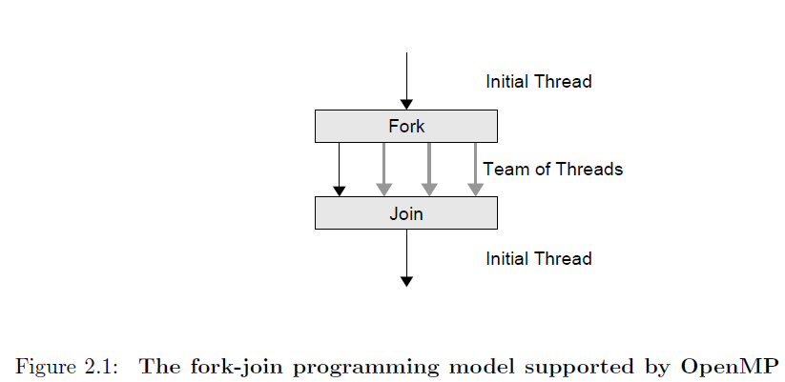
The Idea of OpenMP
Under this approach, the program starts as a single thread of execution, just like a sequential program. The thread that executes this code is referred to as the initial thread. Whenever an OpenMP parallel construct is encountered by a thread while it is executing the program, it creates a team of threads (this is the fork), becomes the master of the team, and collaborates with the other members of the team to execute the code dynamically enclosed by the construct.
At the end of the construct, only the original thread, or master of the team, continues; all others terminate (this is the join). Each portion of code enclosed by a parallel construct is called a parallel region.
OpenMP expects the application developer to give a high-level specification of the parallelism in the program and the method for exploiting that parallelism.
Thus it provides notation for indicating the regions of an OpenMP program that should be executed in parallel; it also enables the provision of additional information on how this is to be accomplished. The job of the OpenMP implementation is to sort out the low-level details of actually creating independent threads to execute the code and to assign work to them according to the strategy specified by the programmer.
The program starts as a single thread of execution, the initial thread. A team of threads is forked at the beginning of a parallel region and joined at the end.

Slide 7
The Feature Set
The OpenMP API comprises a set of compiler directives, runtime library routines, and environment variables to specify shared-memory parallelism in Fortran and C/C++ programs.
An OpenMP directive is a specially formatted comment or pragma that generally applies to the executable code immediately following it in the program.
A directive or OpenMP routine generally affects only those threads that encounter it.
Many of the directives are applied to a structured block of code, a sequence of executable statements with a single entry at the top and a single exit at the bottom in Fortran programs, and an executable statement in C/C++ (which may be a compound statement with a single entry and single exit). In other words, the program may not branch into or out of blocks of code associated with directives.
In Fortran programs, the start and end of the applicable block of code are explicitly marked by OpenMP directives. Since the end of the block is explicit in C/C++, only the start needs to be marked.
OpenMP provides means for the user to
create teams of threads for parallel execution,
specify how to share work among the members of a team,
declare both shared and private variables, and
synchronize threads and enable them to perform certain operations exclusively (i.e., without interference by other threads).

Slide 8
2.3.1 Creating Teams of Threads
A team of threads is created to execute the code in a parallel region of an OpenMP program. To accomplish this, the programmer simply specifies the parallel region by inserting a parallel directive immediately before the code that is to be executed in parallel to mark its start.
Additional information can be supplied along with the parallel directive. This is mostly used to enable threads to have private copies of some data for the duration of the parallel region and to initialize that data.
At the end of a parallel region is an implicit barrier synchronization: this means that no thread can progress until all other threads in the team have reached that point in the program.
Afterwards, program execution continues with the thread or threads that previously existed. If a team of threads executing a parallel region encounters another parallel directive, each thread in the current team creates a new team of threads and becomes its master.
Nesting enables the realization of multilevel parallel programs.
OpenMP is commonly used to incrementally parallelize an existing sequential code, and this task is most easily accomplished by creating parallel regions one at a time.

Slide 9
2.3.2 Sharing Work among Threads
If the programmer does not specify how the work in a parallel region is to be shared among the executing threads, they will each redundantly execute all of the code. This approach does not speed up the program.
The OpenMP work-sharing directives are provided for the programmer to state how the computation in a structured block of code is to be distributed among the threads. Unless explicitly overridden by the programmer, an implicit barrier synchronization also exists at the end of a work-sharing construct.
The choice of work-sharing method may have a considerable bearing on the performance of the program. Work Sharing and Loops Probably the most common work-sharing approach is to distribute the work in a for (C/C++) loop among the threads in a team.
To accomplish this, the programmer inserts the appropriate directive immediately before each loop within a parallel region that is to be shared among threads.
Work-sharing directives cannot be applied to all kinds of loops that occur in C/C++ code. Many programs, especially scientific applications, spend a large fraction of their time in loops performing calculations on array elements and so this strategy is widely applicable and often very effective.
All OpenMP strategies for sharing the work in loops assign one/more disjoint sets of iterations to each thread. The programmer may specify the method used to partition the iteration set.

Slide 10
When Can the Work Be Shared?
The most straightforward strategy assigns one contiguous chunk of iterations to each thread. More complicated strategies include dynamically computing the next chunk of iterations for a thread. If the programmer does not provide a strategy, then an implementation-defined default will be used.
Not every loop can be parallelized in this fashion. It must be possible to determine the number of iterations in the loop upon entry, and this number may not change while the loop is executing. Loops implemented via a while construct, for example, may not satisfy this condition. Furthermore, a loop is suitable for sharing among threads only if its iterations are independent. i.e the order in which the iterations are performed has no bearing on the outcome.
The job of the OpenMP programmer is to determine whether this is the case, and sometimes a loop needs to be modified somewhat to accomplish this.

Slide 11
Other Work-Sharing Strategies
Other approaches may be used to assign work to threads within a parallel region:
One approach consists of giving distinct pieces of work to the individual threads. This approach is suitable when independent computations are to be performed and the order in which they are carried out is irrelevant. It is straightforward to specify this by using the corresponding OpenMP directive. Just as before, the programmer must ensure that the computations can truly be executed in parallel.
It is also possible to specify that just one thread should execute a block of code in a parallel region. Moreover, the OpenMP API contains a directive for sharing the work in Fortran 90 array statements among threads. It also works for the Fortran 95 for all construct. Such operations on an entire array contain considerable exploitable parallelism. The method of distributing the work to threads will be determined by the compiler in this case.

Slide 12
2.3.3 The OpenMP Memory Model
OpenMP is based on the shared-memory model; hence, by default, data is shared among the threads and is visible to all of them. Sometimes, however, one needs variables that have thread-specific values. When each thread has its own copy of a variable, so that it may potentially have a different value for each of them, i.e the variable is private. For example, when a team of threads executes a parallel loop, each thread needs its own value of the iteration variable. This case is so important that the compiler enforces it; in other cases the programmer must determine which variables are shared and which are private. Data can be declared to be shared or private with respect to a parallel region or work-sharing construct.
The use of private variables can be beneficial in several ways. They can reduce the frequency of updates to shared memory. Thus, they may help avoid hot spots, or competition for access to certain memory locations, which can be expensive if large numbers of threads are involved. They can also reduce the likelihood of remote data accesses on cc-NUMA platforms and may remove the need for some synchronizations.

Slide 13
2.3.3 The OpenMP Memory Model
The downside is that they will increase the program’s memory footprint. Threads need a place to store their private data at run time. For this, each thread has its own special region in memory known as the thread stack. Most compilers give the thread stack a default size. But sometimes the amount of data that needs to be saved there can grow to be quite large, as the compiler will use it to store other information, too. Then the default size may not be large enough. However, the application developer is usually provided with a means to increase the size of the thread stack.
Dynamically declared data and persistent data objects require their own storage area.
OpenMP programmer does not need to know how a specific system deals with this problem, since OpenMP has its own rules about when shared data is visible to (or accessible by) all threads. These rules state that the values of shared objects must be made available to all threads at synchronization points. Between the synchronization points, threads may temporarily keep their updated values in local cache. As a result, threads may temporarily have different values for some shared objects. If one thread needs a value that was created by another thread, then a synchronization point must be inserted into the code. OpenMP also has a feature called flush, to synchronize memory. A flush operation makes sure that the thread calling it has the same values for shared data objects as does main memory. Hence, new values of any shared objects updated by that thread are written back to shared memory, and the thread gets any new values produced by other threads for the shared data it reads. In some programming languages, a flush is known as a memory fence, since reads and writes of shared data may not be moved relative to it.

Slide 14
2.3.4 Thread Synchronization
Synchronizing, or coordinating the actions of, threads is necessary in order to ensure the proper ordering of their accesses to shared data and to prevent data corruption.
Open MP has a small set of synchronization features. Ensuring the required thread coordination is one of the toughest challenges of shared-memory programming.
Open MP attempts to reduce the likelihood of synchronization errors, and to make life easier for the programmer, provides for implicit synchronization.
By default, Open MP gets threads to wait at the end of a work-sharing construct or parallel region until all threads in the team executing it have finished their portion of the work. Only then can they proceed. This is known as a barrier.
Synchronizing the actions of a subset of threads is harder to accomplish in OpenMP and requires care in programming because there is no explicit support for this.

Slide 15
Parallel Construct
The parallel construct plays a crucial role in OpenMP: a program without a parallel construct will be executed sequentially.
#pragma omp parallel [clause[[,] clause]. . . ]
structured block
Figure 4.1: Syntax of the parallel construct in C/C++ –
The parallel region implicitly ends at the end of the structured block. This is a closing curly brace (}) in most cases.
This construct is used to specify the computations that should be executed in parallel. When a thread encounters this construct, a team of threads is created to execute the associated parallel region, which is the code dynamically contained within the parallel construct.
But although this construct ensures that computations are performed in parallel, it does not distribute the work of the region among the threads in a team. In fact, if the programmer does not use the appropriate syntax to specify this action, the work will be replicated.
At the end of a parallel region, there is an implied barrier that forces all threads to wait until the work inside the region has been completed. Only the initial thread continues execution after the end of the parallel region.

Slide 16
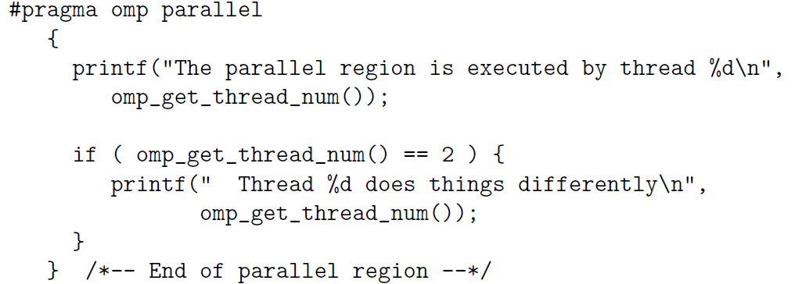
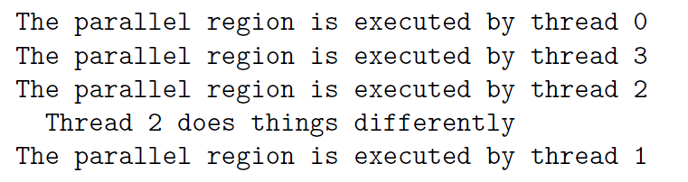
Parallel Construct
The thread that encounters the parallel construct becomes the master of the new team. Each thread in the team is assigned a unique thread number (also referred to as the “thread id”) to identify ranging from 0 to 1- the number of threads within the team, and they can be accessed by the programmer.
Although the parallel region is executed by all threads in the team, each thread is allowed to follow a different path of execution. One way to achieve this is to exploit the thread numbers.
OpenMP library function omp get thread num() is used. Each thread will execute all code in the parallel region, so that we should expect each to perform the first print statement. However, only one thread will actually execute the second print statement (assuming there are at least three threads in the team. When the code is run again, the order of execution could be different.
Example of a parallel region

Slide 17
Clauses supported by the parallel construct
if(scalar-expression) (C/C++)
num threads(integer-expression) (C/C++)
private(list)
firstprivate(list)
shared(list)
default(none|shared) (C/C++)
copyin(list)
reduction(operator:list) (C/C++)
There are several restrictions on the parallel construct and its clauses:
A program that branches into or out of a parallel region is nonconforming.
In other words, if a program does so, then it is illegal, and the behavior is undefined.
A program must not depend on any ordering of the evaluations of the clauses of the parallel directive or on any side effects of the evaluations of the clauses.
At most one if clause can appear on the directive.
At most one num threads clause can appear on the directive. The expression for the clause must evaluate to a positive integer value.

Slide 18
Parallel Construct
Programmer may specify how many threads should be in the team that executes a parallel region. This number cannot be modified once the team has been created.
Under exceptional circumstances, for example, a lack of hardware resources, an implementation is permitted to provide fewer than the requested number of threads. Thus, the application may need to check on the number actually assigned for its execution.
The OpenMP standard distinguishes between an active parallel region and an inactive parallel region.
A parallel region is active if it is executed by a team of threads consisting of more than one thread. If it is executed by one thread only, it has been serialized and is considered to be inactive.

Slide 19
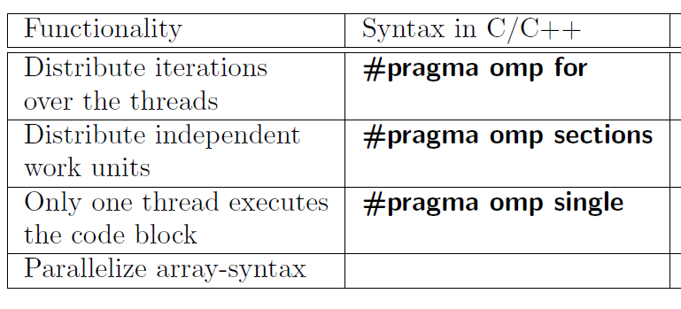
Sharing the Work among Threads in an OpenMP Program
OpenMP’s work-sharing constructs are the next most important feature of OpenMP because they are used to distribute computation among the threads in a team.
C/C++ has 3 work-sharing constructs. A work-sharing construct, along with its terminating construct where appropriate, specifies a region of code whose work is to be distributed among the executing threads; it also specifies the manner in which the work in the region is to be parceled out. A work-sharing region must bind to an active parallel region in order to have an effect.
If encountered in an inactive parallel region or in the sequential part of the program, it is ignored.
2 main rules regarding work-sharing constructs are as follows:
Each work-sharing region must be encountered by all threads in a team or by none at all.
The sequence of work-sharing regions and barrier regions encountered must be the same for every thread in a team.
A work-sharing construct does not launch new threads and does not have a barrier on entry. By default, threads wait at a barrier at the end of a work-sharing region until the last thread has completed its share of the work. However, the programmer can suppress this by using the nowait clause

Slide 20
Loop Construct
The most widely used loop construct causes the iterations of the loop immediately following it to be executed in parallel. At run time, the loop iterations are distributed across the threads
#pragma omp for [clause[[,] clause]. . . ]
for-loop
Use of this construct is limited to those kinds of loops where the number of iterations can be counted; i.e, the loop must have an integer counter variable whose value is incremented (or decremented) by a fixed amount at each iteration until some specified upper (or lower) bound is reached.
In particular, this restriction excludes loops that process the items in a list.
The loop header must have the general form shown - for ( init-expr ; var relop b ; incr-expr ), where init-expr stands for the initialization of the loop counter var via an integer expression, b is only to this kind of loop nest in C/C++ programs. also an integer expression, and relop is one of the following: <, <=, >, >=.
The incr-expr is a statement that increments or decrements var by an integer amount using a standard operator (++, –, +=, -=). Alternatively, it may take a form such as var = var + incr.

Slide 21
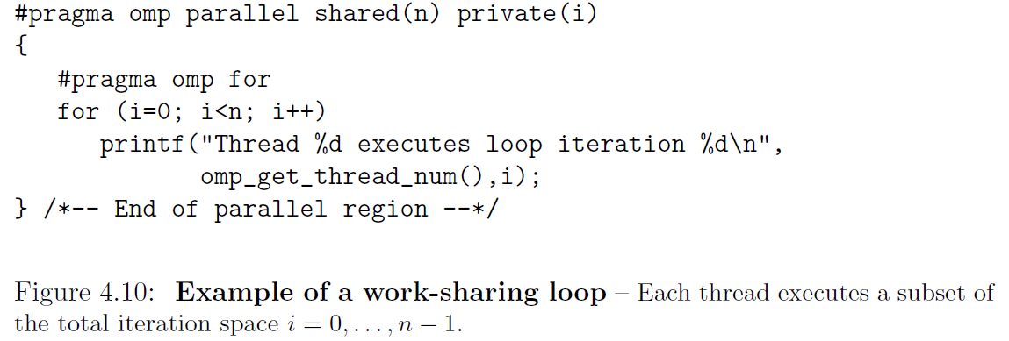
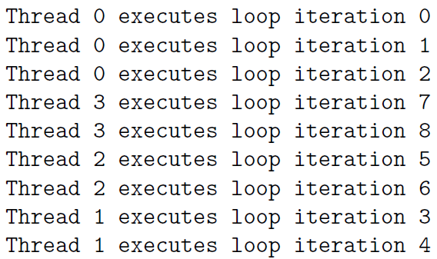
Loop Construct
#pragma omp for directive states that iterations of the loop following it will be distributed. Within the loop, omp get thread num(), obtains and print the number of the executing thread in each iteration. Note that we have added clauses to the parallel construct that state which data in the region is shared and which is private.
Given that this is a parallel program, results will be printed in a deterministic order.
Note that threads 1, 2, and 3 execute two loop
– The example is executed for n = 9 and uses four threads.
Since the total number of iterations is 9 and since four threads are
used, one thread has to execute the additional iteration. In this case it turns out to be thread 0, the so-called master thread, which has done so. The implementer must decide how to select a thread to execute the remaining
iteration(s), and the choice may even change between various releases of the same
compiler. In fact, if the programmer does not say how to map the iterations to
threads, the compiler must decide what strategy should be used for this. Potentially,
it could even choose a different mapping strategy for different loops in the same
application. Another of the clauses, the schedule clause (see Section 4.5.7 on page
79), is the means by which the programmer is able to influence this mapping. Our
second example in Figure 4.12 contains two work-shared loops, or parallel loops.
The second loop uses values of a that are defined in the first loop. As mentioned
above, the compiler does not necessarily map iterations of the second loop in the
same way as it does for the first loop. But since there is an implied barrier at the
end of a parallel loop, we can be certain that all of the values of a have been created
by the time we begin to use them.
The clauses supported by the loop construct are listed in Figure 4.13.

Slide 22
Loop Construct
The implementer must decide how to select a thread to execute the remaining iteration(s), and the choice may even change between various releases of the same compiler.
In fact, if the programmer does not say how to map the iterations to threads, the compiler must decide what strategy should be used for this.
Another of the clauses, the schedule clause is the means by which the programmer is able to influence this mapping.

Slide 23
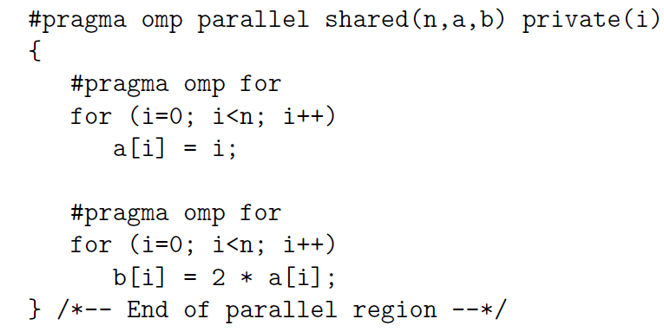
Loop Construct
Ex: 2 work-shared loops, or parallel loops.
The second loop uses values of a that are defined in the first loop.
Compiler does not necessarily map iterations of the second loop in the same way as it does for the first loop. But since there is an implied barrier at the end of a parallel loop, it can be certain that all of the values of a have been created by the time it is begun to use.
The clauses supported by the loop construct are
private(list)
firstprivate(list)
lastprivate(list)
reduction(operator:list) (C/C++)
ordered
schedule (kind[,chunk size)]
nowait

Slide 24
Sections Construct
The sections construct is the easiest way to get different threads to carry out different kinds of work, since it permits to specify several different code regions, each of which will be executed by one of the threads.
It consists of two directives: #pragma omp sections in C/C++ to indicate the start of the construct, and second, the #pragma omp section directive.
Each section must be a structured block of code that is independent of the other sections.
At run time, the specified code blocks are executed by the threads in the team.
Each thread executes one code block at a time, and each code block will be executed exactly once. If there are fewer threads than code blocks, some or all of the threads execute multiple code blocks. If there are fewer code blocks than threads, the remaining threads will be idle.
The assignment of code blocks to threads is implementation-dependent.
Although the sections construct is a general mechanism that can be used to get threads to perform different tasks independently, its most common use is probably to execute function or subroutine calls in parallel.

Slide 25
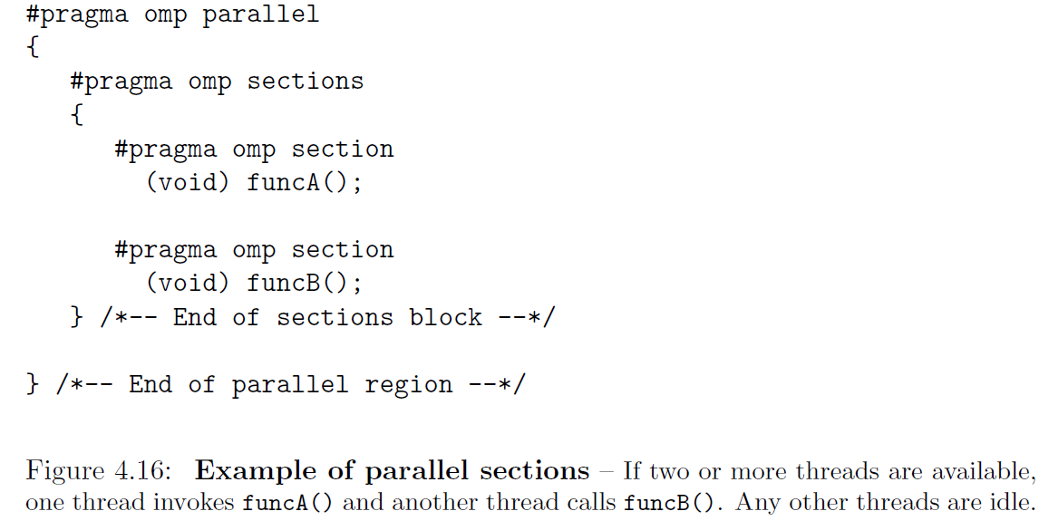
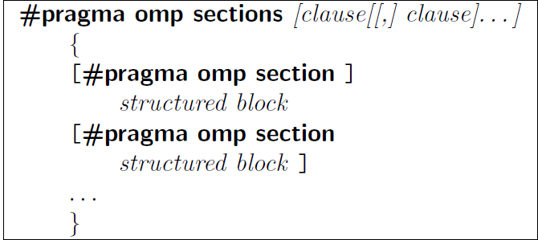
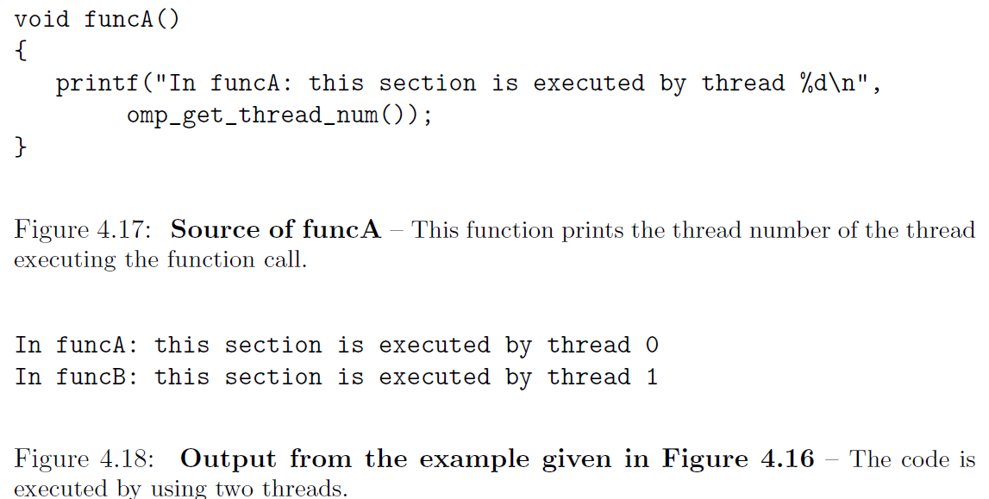
Sections Construct

Slide 26
T
Depending on the type of work performed in the various code blocks and the number of threads used, this construct might lead to a load-balancing problem. This occurs when threads have different amounts of work to do and thus take different amounts of time to complete.
A result of load imbalance is that some threads may wait a long time at the next barrier in the program, which means that the hardware resources are not being efficiently exploited. Ex, there are 5 equal-sized code blocks and only 4 threads are available, 1 thread has to do more work. If a lot of computation is involved, other strategies may need to be considered.
The clauses supported by the sections construct are
private(list)
firstprivate(list)
lastprivate(list)
reduction(operator:list) (C/C++)
Nowait

Slide 27
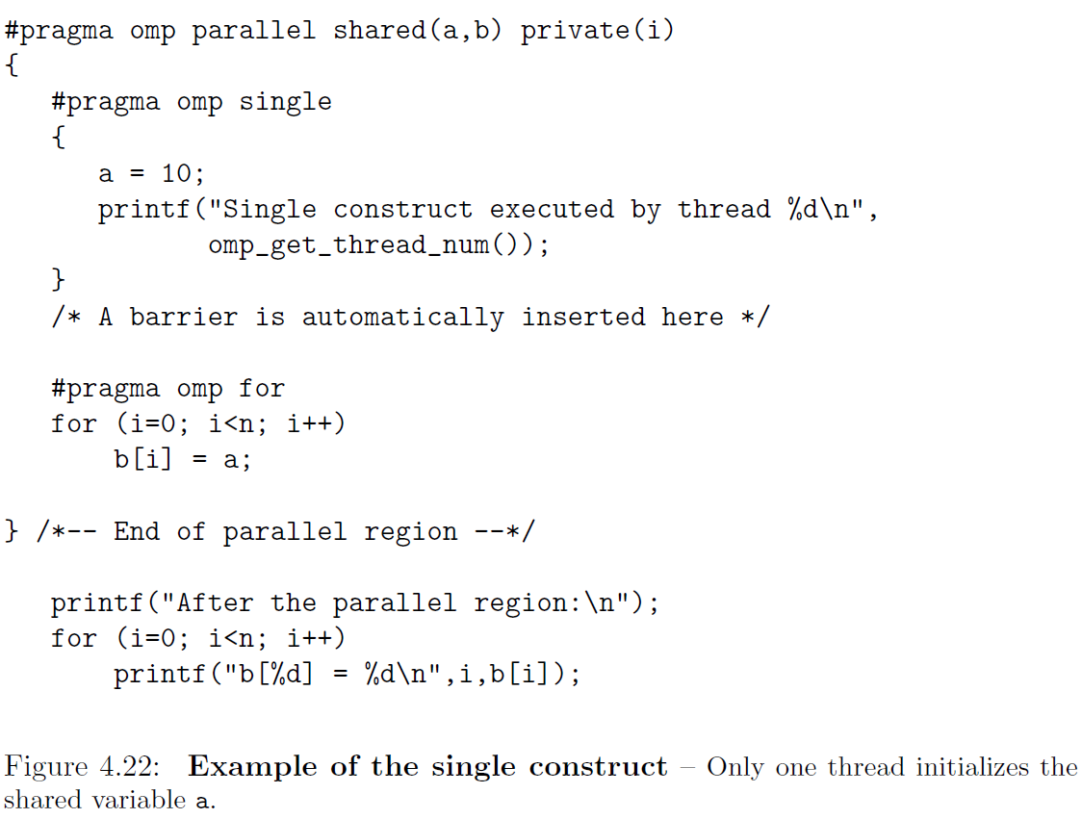
Single Construct
The single construct is associated with the structured block of code immediately following it and specifies that this block should be executed by one thread only.
It does not state which thread should execute the code block; indeed, the thread chosen could vary from one run to another. It can also differ for different single constructs within one application. This is not a limitation, however, as this construct should really be used when we do not care which thread executes this part of the application, as long as the work gets done by exactly one thread. The other threads wait at a barrier until the thread executing the single code block has completed.
#pragma omp single [clause[[,] clause]. . . ]
structured block

Slide 28
Single Construct
The code fragment demonstrates the use of the single construct to initialize a shared variable. 1 thread initializes the shared variable a. This variable is then used to initialize vector b in the parallelized for-loop.
Note: On theoretical grounds one might think the single construct can be omitted in this case. After all, every thread would write the same value of 10 to the same variable a. However, this approach raises a hardware issue.
Depending on the data type, the processor details, and the compiler behavior, the write to memory might be translated into a sequence of store instructions, each store writing a subset of the variable. For example, a variable 8 bytes long might be written to memory through 2 store instructions of 4 bytes each. Since a write operation is not guaranteed to be atomic,6 multiple threads could do this at the same time, potentially resulting in an arbitrary combination of bytes in memory.
The other point is that, in this case, a barrier is essential before the #pragma omp for loop. Without such a barrier, some threads would begin to assign values to elements of b before a has been assigned a value, a particularly nasty kind of bug. Luckily there is an implicit barrier at the end of the single construct.

Slide 29
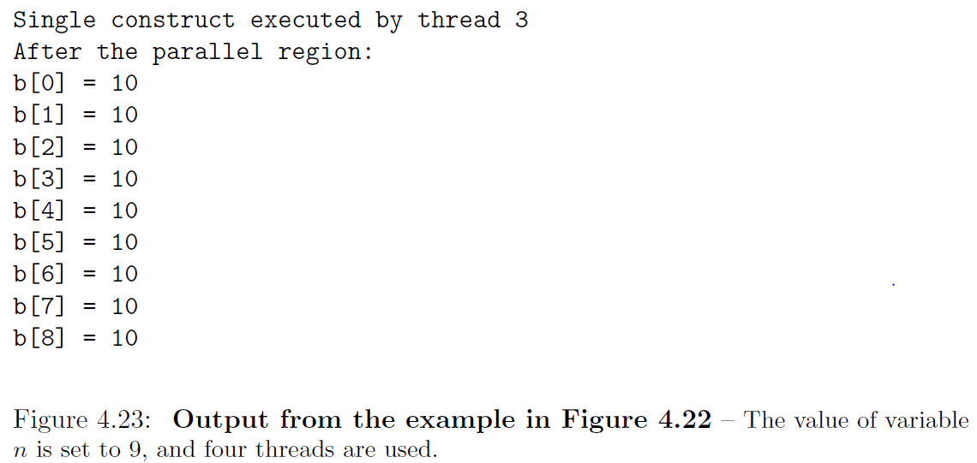
Single Construct
The clauses supported by the single construct are listed
private(list)
firstprivate(list)
copyprivate(list)
nowait
A similar construct, master guarantees that a code block is executed by the master thread. It does not have an implied barrier.

